Slide 1

Page - 1
BUDGE BUDGE INSTITUTE OF TECHNOLOGY
Affiliated to MAKAUT(formerly WBUT)& Approved by AICTE, NAAC Accredited
Kolkata - 700 137, West Bengal, India
Department of Computer Science and Engineering
June , 2026
Major Project Presentation
Topic:- Deep Learning Based Encoder and Decoder
Presented by:
Rupam Moitra:- 27600122067
Arbind Kumar Ray:- 27600122032
Aatif Aslam:- 27600120081
Subhodip Chakraborty:- 27600122087
Archna Kumari:- 27600122151
Supervisor:- Dr. Rajat Suvra Nandy

Slide 2

Page - 2
Develop an automated retinal blood vessel segmentation system based on the Encoder–Decoder concept.
Use retinal fundus images from the DRIVE dataset for analysis.
Improve image quality through preprocessing techniques such as Gaussian Blur and Thresholding.
Extract retinal blood vessels accurately using the implemented segmentation workflow.
Compare segmented images with expert-annotated ground truth masks.
Evaluate performance using Accuracy, Precision, Recall, Specificity, and F1-Score.

Slide 3

Page - 3
Develops an automated retinal blood vessel segmentation system using retinal fundus images from the DRIVE dataset.
Applies image preprocessing techniques such as Gaussian Blur and Thresholding to improve vessel extraction.
Segments retinal blood vessels and compares the results with expert-annotated ground truth masks.
Evaluates system performance using Accuracy, Precision, Recall, Specificity, and F1-Score.
Provides a simple and reproducible workflow that can be extended for future deep learning–based medical image analysis.

Slide 4

Page - 4
Previous studies have shown that retinal blood vessel segmentation is an important step for the early detection of DR and other retinal diseases.
Traditional image processing methods such as filtering, thresholding, are simple but often fail to detect thin blood vessels accurately.
Recent research has focused on Encoder–Decoder architectures, which improve segmentation accuracy by learning complex vessel features automatically.
Performance of segmentation methods is commonly evaluated using Accuracy, Precision, Recall, Specificity, and F1-Score.

Slide 5
Page - 5
Programming Language
Python
Development Environment
Google Colaboratory
Dataset
DRIVE Dataset
Libraries
OpenCV
NumPy
Matplotlib
Scikit-learn
Image Processing Techniques
Gaussian Blur
Thresholding
Pixel-wise Comparison
Evaluation Metrics
Accuracy
Precision
Recall
Specificity
F1-Score

Slide 6



Page - 6
Load retinal fundus images and corresponding ground truth masks from the DRIVE dataset.
Perform image preprocessing to reduce noise and enhance retinal image quality.
Apply Gaussian Blur and Thresholding to accurately extract retinal blood vessels.
Compare the segmented blood vessels with expert-annotated ground truth masks using pixel-wise comparison.
Evaluate the segmentation performance using Accuracy, Precision, Recall, Specificity, and F1-Score.
Provide a simple, reliable, and reproducible workflow for automated retinal blood vessel segmentation.

Slide 7
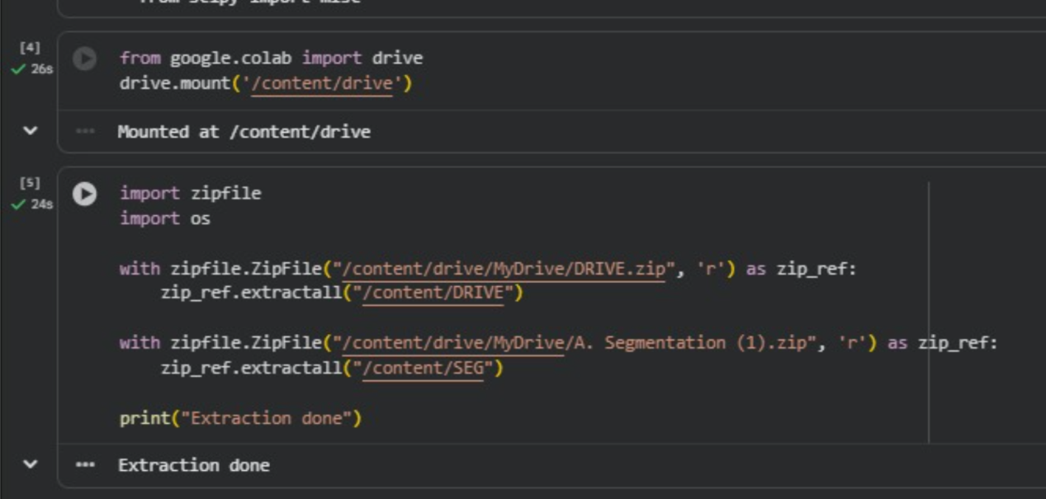
Dataset Loading
Page - 7
Dataset & Image Loading
Development Environment

Slide 8
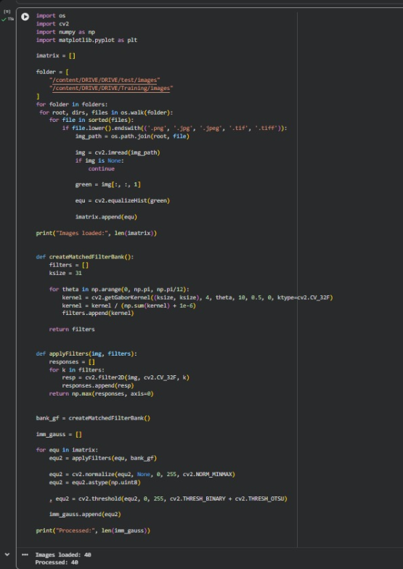
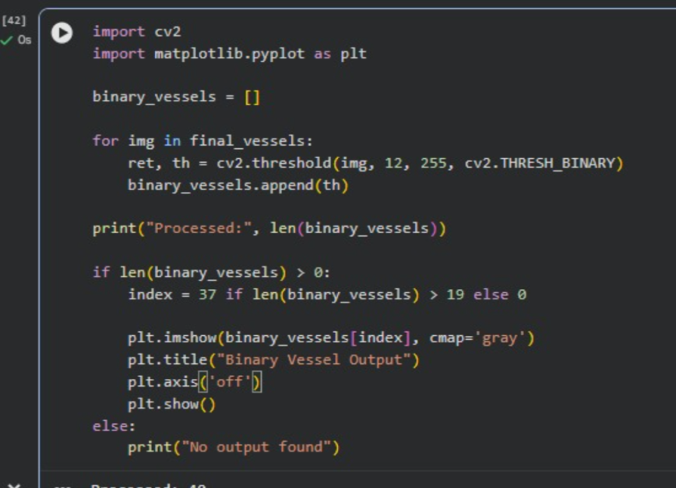
Image Processing & Segmentation
Image Preprocessing
Final Blood Vessel Segmentation

Slide 9
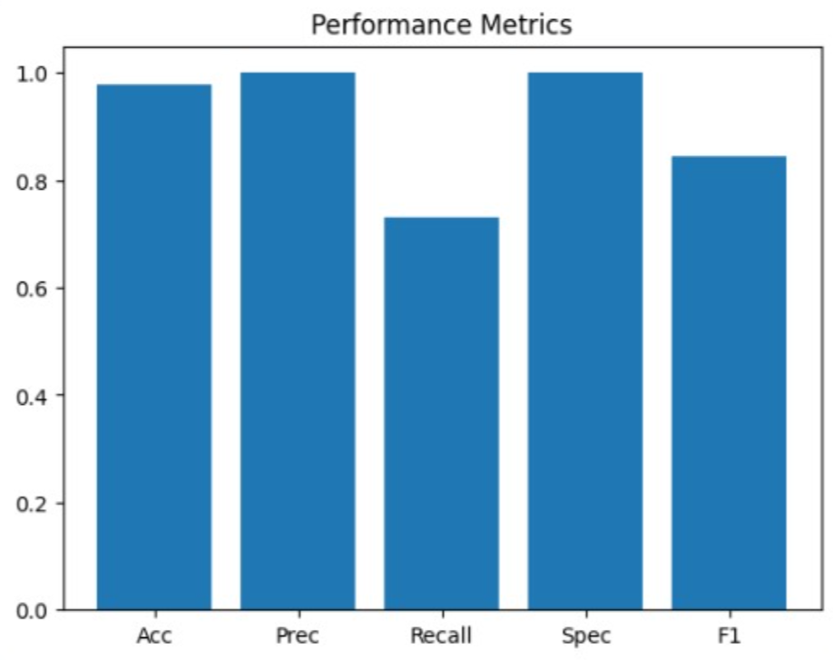
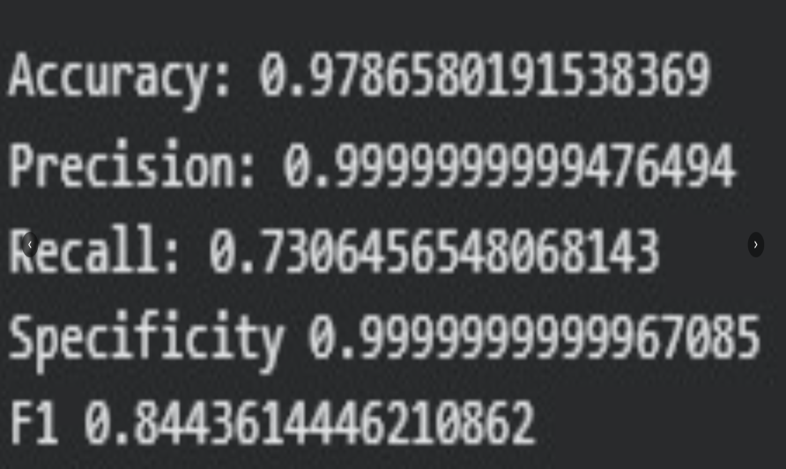
Results & Performance Evaluation
Performance Evaluation Output
Statistical Graph

Slide 10

Page - 8
Successfully developed an automated retinal blood vessel segmentation workflow using the DRIVE dataset and image preprocessing techniques.
The proposed approach effectively extracted retinal blood vessels and evaluated performance using Accuracy, Precision, Recall, Specificity, and F1-Score.
The Encoder–Decoder concept provides a strong theoretical foundation for advanced retinal image segmentation and future deep learning applications.
The proposed system can support early detection of Diabetic Retinopathy (DR) and serve as a foundation for future computer-aided diagnosis systems.

Slide 11
Page - 9
Reference
Li, R., et al., "Rethinking the U-Net Architecture Design for Retinal Blood Vessel Segmentation," IEEE Transactions on Medical Imaging, vol. 42, no. 8, pp. 2215–2228, 2023.
Zhang, Y., et al., "Deep Learning-Based Retinal Vessel Segmentation: A Survey," Computer Methods and Programs in Biomedicine, vol. 235, 2023.
Staal, J., Abramoff, M. D., Niemeijer, M., Viergever, M. A., & van Ginneken, B., "Ridge-Based Vessel Segmentation in Color Images of the Retina," IEEE Transactions on Medical Imaging, vol. 23, no. 4, pp. 501–509, 2004.
DRIVE Dataset (Digital Retinal Images for Vessel Extraction)

Slide 12


